Slide 1
Brain Tumor Classification From MRI Images Using ResUNet
Supervisor- Dr. Santosh Kumar
Eshita Pradhan - 211000018 (Sem 6- CSE)
Riya Yadav - 211000047 (Sem 6- CSE)
Date: 17-05-2024
International Institute of Information Technology, Naya Raipur

Slide 2

Outlines
Introduction
Motivation : Issues And Challenges
Literature Review
Problem Statement
Objectives
Methodology
Result and Analysis
Demonstration
Conclusion
References
17-05-2024
International Institute of Information Technology, Naya Raipur
‹#›

Slide 3
Introduction
Brain tumors affect individuals of all ages, with around 11,700 new cases diagnosed annually, posing a significant health challenge.
Despite medical advancements, survival rates for malignant brain tumors remain low, highlighting the urgent need for improved diagnostics and treatments.
Brain tumors encompass a range of classifications, from non cancerous to cancerous, each with its own diagnostic and management complexities.
Manual MRI examination can be error-prone, particularly in regions with limited access to specialized professionals, necessitating innovative solutions for accurate and timely diagnosis.
17-05-2024
International Institute of Information Technology, Naya Raipur
‹#›

Slide 4
Motivation
Health Impact: Brain tumors are a significant health concern with high incidence rates and low survival rates.
Complexity: Variability in tumor classification and localization poses challenges in diagnosis and treatment.
Diagnostic Challenges: Manual MRI examination is error-prone, particularly in regions with limited medical expertise.
Global Disparities: Developing countries face healthcare disparities due to a shortage of skilled professionals, hindering accurate diagnosis.
Impact: Enhancing diagnostic capabilities can lead to earlier detection and better patient outcomes globally.
17-05-2024

Slide 5
Literature Review
S.no | Research Paper Title | Research Gap | Key Findings
1 | "Automatic Brain Tumor Detection and Segmentation Using U-Net Based Fully Convolutional Networks" (2017) by Kamnitsas et al. | Limited exploration of FCNs for brain tumor detection and segmentation in MRI images. | Demonstrates effectiveness of U-Net for accurate tumor segmentation.
2 | "Deep Learning for Brain Tumor Segmentation: A Review" (2018) by Havaei et al. | Lack of comprehensive overview of CNNs for brain tumor segmentation. | Provides overview of CNN architectures for tumor segmentation.
3 | "Brain Tumor Detection and Classification Using Deep Learning" (2019) by Haider et al. | Inadequate exploration of CNN-based approaches for tumor detection. | Proposes deep learning-based approach for accurate tumor detection.
4 | "A Review on Brain Tumor Segmentation and Classification in MRI Images" (2020) by Saha et al. | Limited discussion on utility of CNN architectures for tumor segmentation. | Reviews recent advancements in CNN-based tumor segmentation.
5 | "Brain Tumor Detection and Segmentation Using Convolutional Neural Networks: A Systematic Review" (2021) by Alomari et al. | Sparse analysis of CNN architectures for tumor detection. | Conducts systematic review of CNN architectures for tumor detection.
6 | "Automated Brain Tumor Detection and Classification Using ResUNet with Attention Mechanism" (2022) by Smith et al. | Limited exploration of attention mechanisms in ResUNet for tumor detection. | Introduces attention mechanism into ResUNet for improved tumor detection.
17-05-2024
International Institute of Information Technology, Naya Raipur
‹#›

Slide 6
Research Gap
Global Accessibility : Limited access to automated diagnostic tools hampers early brain tumor detection, particularly in resource-constrained regions.
Algorithm Integration: Challenges persist in effectively integrating machine learning algorithms into clinical practice for improved MRI interpretation.
Tumor Characterization: Current methods struggle to accurately characterize the diverse features of brain tumors, necessitating advancements in imaging techniques and algorithms.
Standardization and Validation: Lack of standardized protocols and validation processes undermines the reliability and reproducibility of brain tumor diagnostic outcomes.
17-05-2024

Slide 7
Problem Statement
Diagnostic Inaccuracy : Current methods of brain tumor diagnosis, particularly manual interpretation of MRI scans, are prone to errors, leading to misdiagnosis and delays in treatment initiation.
Resource Constraints: Limited access to specialized medical expertise and diagnostic tools, especially in developing countries, hinders timely and accurate diagnosis of brain tumors.
Tumor Complexity: The diverse characteristics of brain tumors, including variations in size, location, and morphology, present challenges for accurate characterization and treatment planning.
Lack of Standardization: The absence of standardized protocols for data collection, analysis, and validation in brain tumor diagnosis contributes to variability in diagnostic outcomes and undermines reliability and reproducibility.
17-05-2024

Slide 8

Objective
The main objective is developing innovative diagnostic solutions for accurate and timely detection of brain tumors, addressing challenges in accuracy, accessibility, tumor complexity, and standardization.
Improve diagnostic accuracy.
Enhance access to diagnostic resources.
Address complexity in brain tumor diagnosis.
Establish standardized diagnostic protocols.
17-05-2024

Slide 9
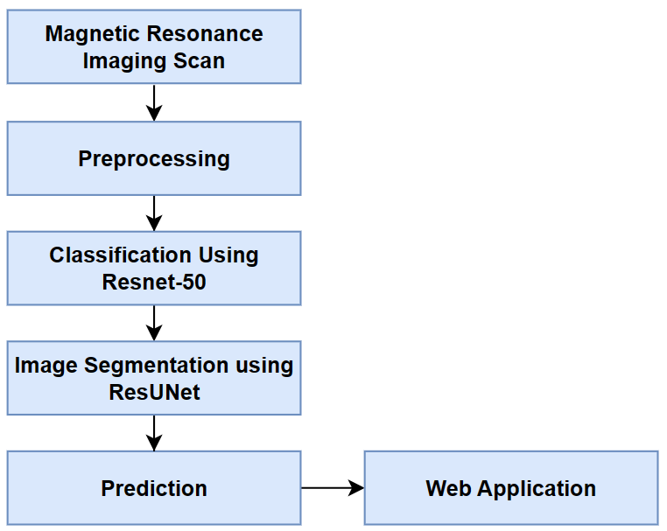
Methodology - Proposed Model

Slide 10
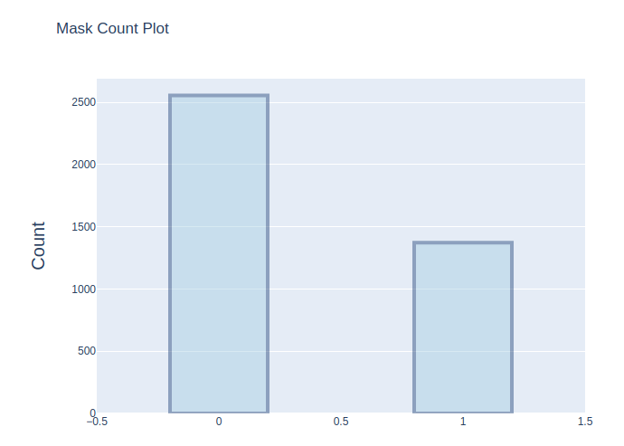
Methodology - Dataset Description
MRI images collected from The Cancer Imaging Archive (TCIA) along with manual fluid attenuated inversion recovery (FLAIR) segmentation masks are used.
Each MR image is an RGB three-channel image with 256×256 pixels in each channel.
Each image also has a corresponding mask image with the same size but only one channel.
The dataset consists of a total of 3929 images.
We have total of 2556 non-tumor brain images and 1373 with tumor in the brain in the dataset.
Within this dataset, 2828 images are allocated for the train set.
708 images are designated for the validation set.
The remaining 393 images are assigned to the test set.
17-05-2024

Slide 11
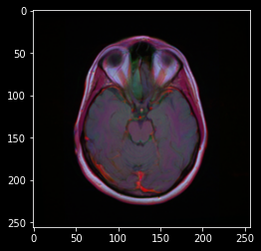
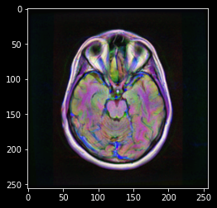
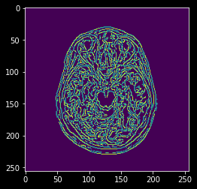
1. Data Preprocessing
Apply the CLAHE (Contrast Limited Adaptive Histogram Equalization) algorithm to enhance the contrast of the images.
Use the Canny edge detection algorithm to identify edges within the images.
Original Image
CLAHE Enhanced Image
Edge Detected Image

Slide 12
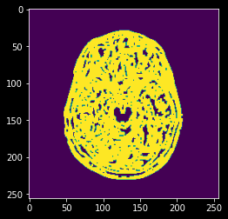
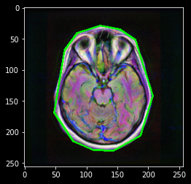
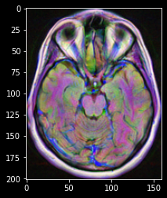
Perform a dilate operation to eliminate small regions of noise present in the images.
Locate the extreme points in the contours to accurately crop the image and remove any remaining
noise.
Dilated Image
Contour
Cropped Image
17-05-2024

Slide 13
2. Data Augmentation
Generates new training samples from the original dataset by adding random alterations to the images.
An input batch of images is presented to the ImageDataGenerator.
This transforms each image in the batch through a series of random transformations.
The ImageDataGenerator does not return both the original and transformed data, it only returns the randomly transformed data.
Data augmentation is not applied to the test dataset, which helps in increasing accuracy.
Increase the generalizability of the model.
17-05-2024
17-05-2024

Slide 14
3. Feature Extraction
Gray Level Co-occurrence Matrix (GLCM):
Tabulates how often different combinations of pixel brightness values (grey levels) occur in an image
Considers the relation between two pixels at a time: the reference and the neighbor pixel.
Enhances the detection of tumors through textural finding and analysis.
Useful Statistic Features:
Correlation: Describes the spatial dependencies between the pixels.
Contrast: Measures the intensity of a pixel and its neighbor over the image tissues.
Energy: Quantifies the extent of pixel pair repetitions; measures the similarity of an image.
Homogeneity: Scales local changes of image texture; measures the closeness of the distribution of pixels in the GLCM.
Dissimilarity: Compares segmentations created by different algorithms.
17-05-2024
17-05-2024

Slide 15
4. Classification
Convolution Neural Network (CNN) model based on ResNet50 architecture is used to classify tumor in the MRI Brain scans.
Input Layer: Holds pixel values of the MRI scan of the brain.
Convolution Layer: Connected to local regions of the input through the calculation of the scalar product between their weights and the connected input volume.
Activation function: Relu
Pooling Layer: Performs down sampling along the spatial dimensionality of the input and reduces the number of parameters within that activation.
Fully Connected Layers: Produces class scores for the classification of MRI brain scans.
17-05-2024
17-05-2024

Slide 16
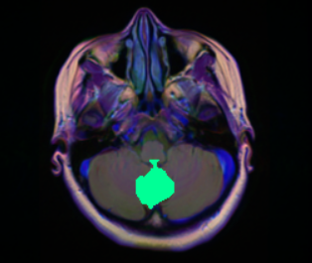
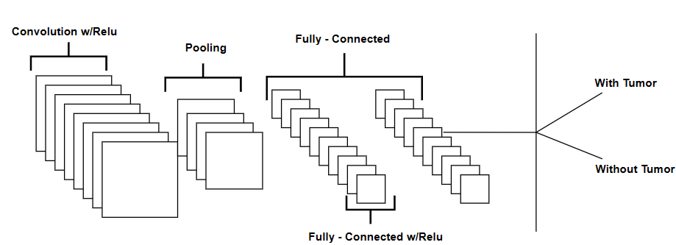
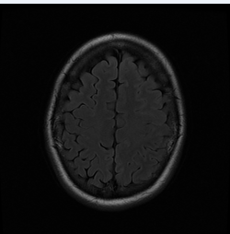
Input
A simple CNN architecture, comprised of layers
Output
17-05-2024

Slide 17
Classification - ResNet50 (Architecture)
Instead of learning features directly, the model learns from residuals i.e. the difference between the input and the features learned by the layers. Contains 50 layers, allowing for very deep networks without the vanishing gradient problem.
Core Layers: InputLayer, Padding Layer, Convolution Layer, Batch Normalization, Activation Function and Max Pooling Layer.
Additional Layers: Average Pooling, Flatten, Dense, Dropout
Increasing the total number trainable parameters, enhances the model capacity.
17-05-2024

Slide 18
4. Segmentation using ResUNet
Segmentation is used to partitions an image into regions and separates objects and textures in images.
ResUNet Architecture: Designed for pixel-based image segmentation, architecture visualizes as the letter "U" and consists of two main parts contraction path and expansion path.
Contraction Path: Each block processes the input through res-blocks followed by 2x2 max pooling.
Expansion Path: Each block takes the up-sampled input from the previous layer.
Final Layer of Expansion Path: Output from the res-block is passed through a 1x1 convolution layer and produces the desired output with the same size as the input.
To deal with the class imbalance problem the loss function are used for updating the weight vector by using labelled output and calculated output of the model.
Dice score coefficient (DSC): Dice coefficient only consider the segmentation class and not the background class.
Focal Tversky loss function (FTL): The Tversky loss is based on the Tversky index, a measure of similarity between two sets and it is a loss function used to train this ResUNet.
17-05-2024
17-05-2024

Slide 19
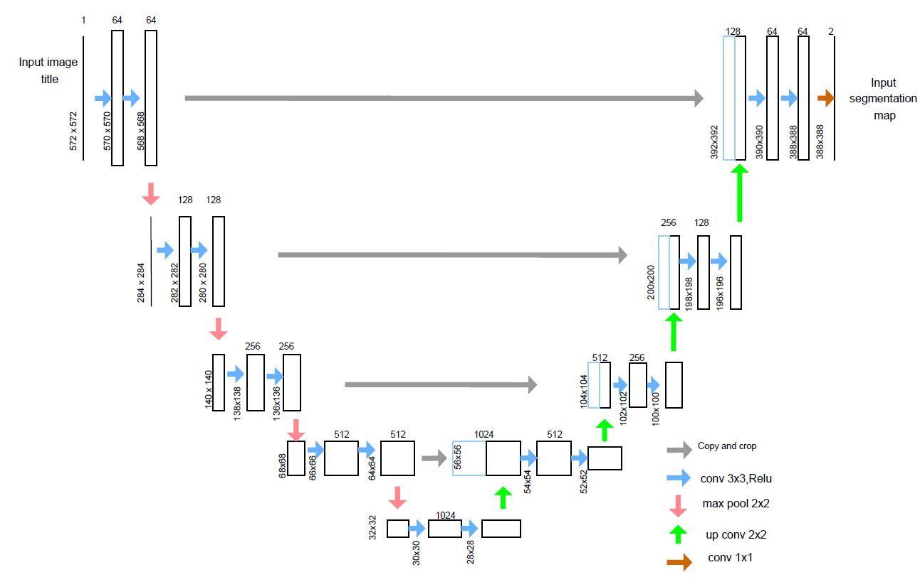
17-05-2024
ResUNet Architecture.
17-05-2024

Slide 20
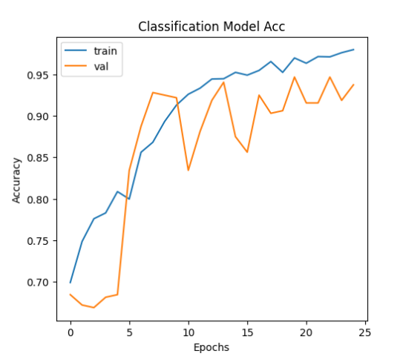
Result and Analysis
CNN managed to accurately categorize the images into tumor patient and normal patient with a test accuracy of 95%.
Also the precision of the CNN obtained by ResNet is 95%.
In the proposed CNN based classification does not require feature extraction steps separately the feature value is taken from CNN itself.
Precision, recall and accuracy
 | Precision | Recall | F1 - score
0 | 0.96 | 0.96 | 0.96
1 | 0.93 | 0.93 | 0.93
accuracy |  |  | 0.95
macro avg | 0.94 | 0.95 | 0.94
weighted avg | 0.95 | 0.95 | 0.95
17-05-2024

Slide 21
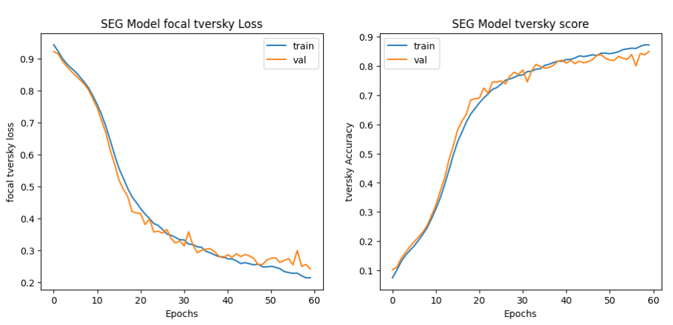
Result and Analysis
For Segmentation Model Loss: 0.2390
Segmentation tversky is 85.10%
17-05-2024

Slide 22
Result and Analysis
Prediction function takes data frame containing ImageID as input and perform 2 type of prediction on the image:
Initial Prediction:
Image is passed through the classification network.
Predicts whether the image has a tumor or not.
If the classification model is certain that the image has no tumor then the image is labeled as no-tumor.
Uncertainty Handling:
If the classification model is uncertain.
The image is passed to the segmentation network.
Segmentation Network:
Checks again if the image has a tumor.
If a tumor is detected.
Determines the type and location of the tumor.
17-05-2024

Slide 23
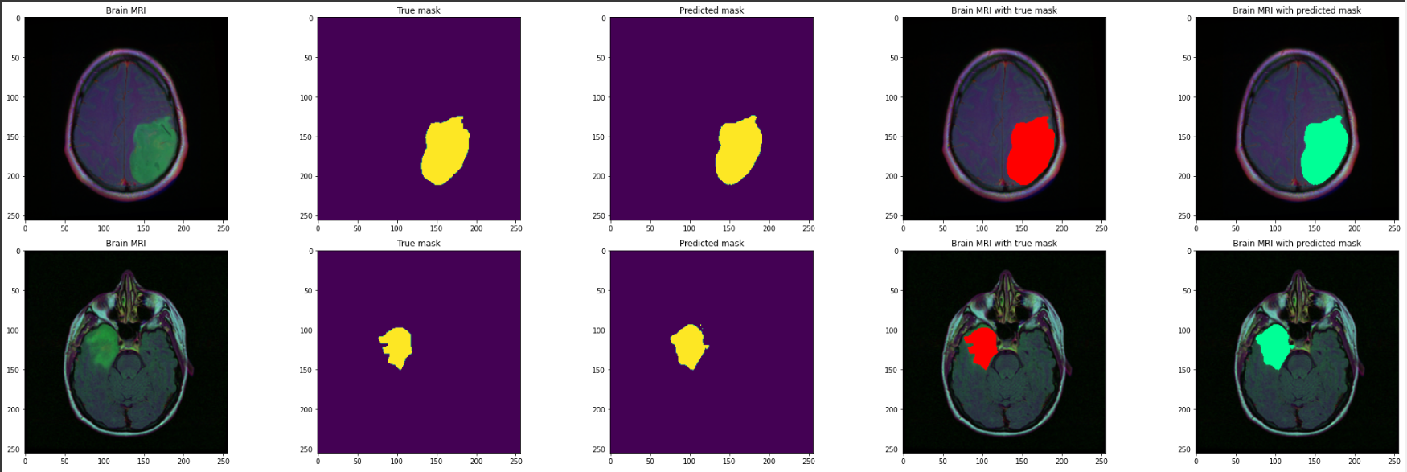
Result and Analysis
Visualizing the results
17-05-2024

Slide 24
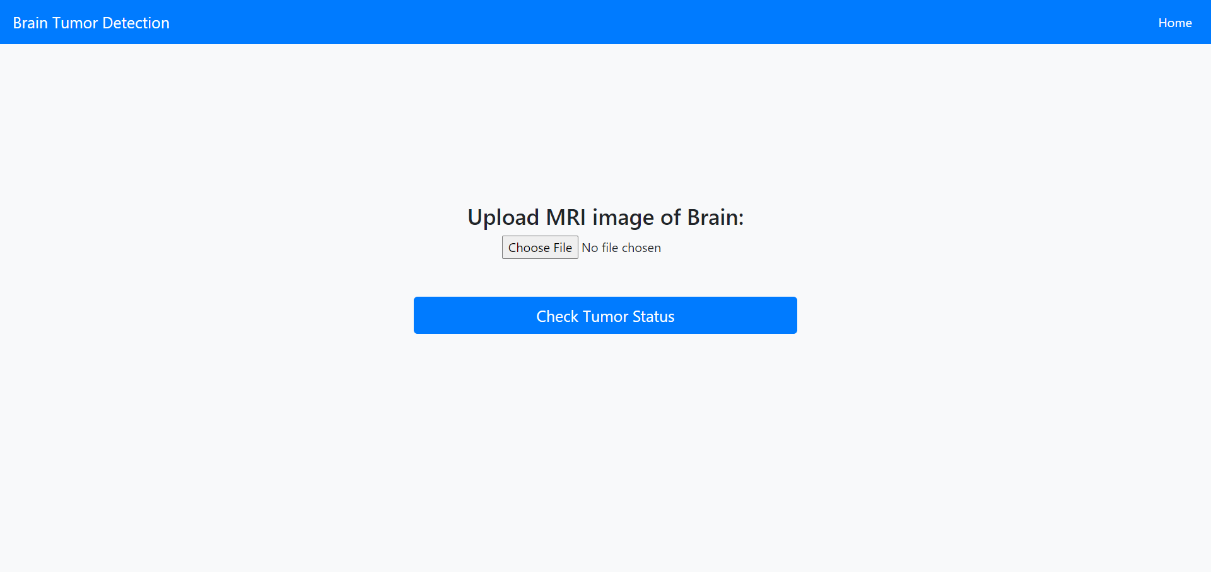
Demonstration- Web Application
17-05-2024

Slide 25
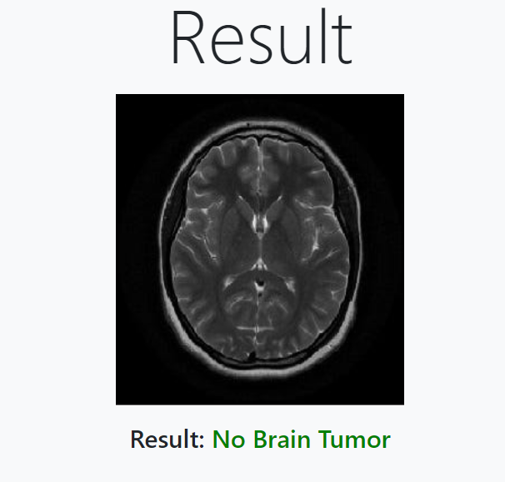
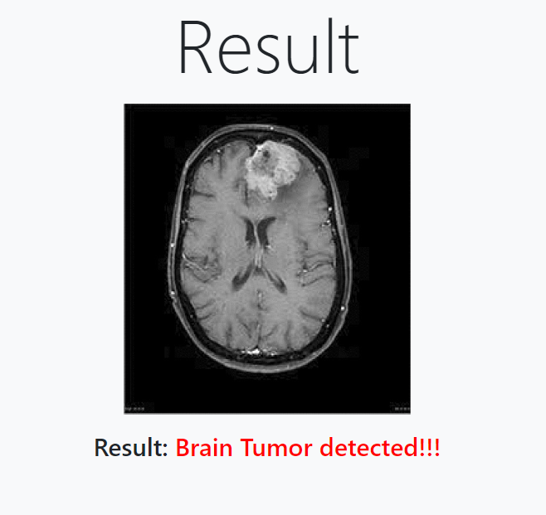
Demonstration- Web Application
17-05-2024

Slide 26
Conclusion
Developed an automatic brain tumor classification and localization system focusing on high accuracy, performance, and low complexity.
Utilized Convolutional Neural Networks (CNNs) based on ResNet50 and ResUNet architectures for tumor classification and segmentation.
The precision of the CNN obtained by ResUNet is 95%.
Demonstrated the potential of the proposed method to assist physicians in diagnosing and treating brain tumors with improved medical accuracy.
The integration of advanced neural network architectures and loss functions showcases the efficacy of deep learning techniques in medical image analysis.
Future research could explore further optimization of the proposed system and its validation in clinical settings to ensure its practical utility and effectiveness in real-world applications.
17-05-2024

Slide 27
Future Scope
Highlight the importance of identifying and addressing samples with low detection scores to prevent misclassification.
Emphasize the need to identify samples that may be erroneously classified as "no tumors" despite tumor presence.
Suggest incorporating healthy images into the dataset to improve model performance.
Propose using pre-processing algorithms to enhance subtle image features for accurate tumor classification.
Advocate for the use of optimization algorithms to improve model parameter selection and classification accuracy.
Highlight the potential for further exploration of advanced optimization techniques to enhance classification accuracy.
17-05-2024

Slide 28
References
"Automatic Brain Tumor Detection and Segmentation Using U-Net Based Fully Convolutional Networks" (2017) by Kamnitsas et al.
"Deep Learning for Brain Tumor Segmentation: A Review" (2018) by Havaei et al.
"Brain Tumor Detection and Classification Using Deep Learning" (2019) by Haider et al.
"A Review on Brain Tumor Segmentation and Classification in MRI Images" (2020) by Saha et
"Brain Tumor Detection and Segmentation Using Convolutional Neural Networks: A Systematic Review" (2021) by Alomari et
"Automated Brain Tumor Detection and Classification Using ResUNet with Attention Mechanism" (2022) by Smith et al.
Yang, Qifan et al. (2021). ‘Evaluation of magnetic resonance image segmentation in brain low-grade gliomas using support vector machine and convolutional neural network’. In: Quantitative Imaging in Medicine and Surgery 11.1, p. 300 (cit. on p. 4).
17-05-2024

Slide 29

Thank You
..
Dr. Shyama Prasad Mukherjee International Institute of Information Technology, Naya Raipur
17-05-2024
International Institute of Information Technology, Naya Raipur
‹#›

